Slide 1
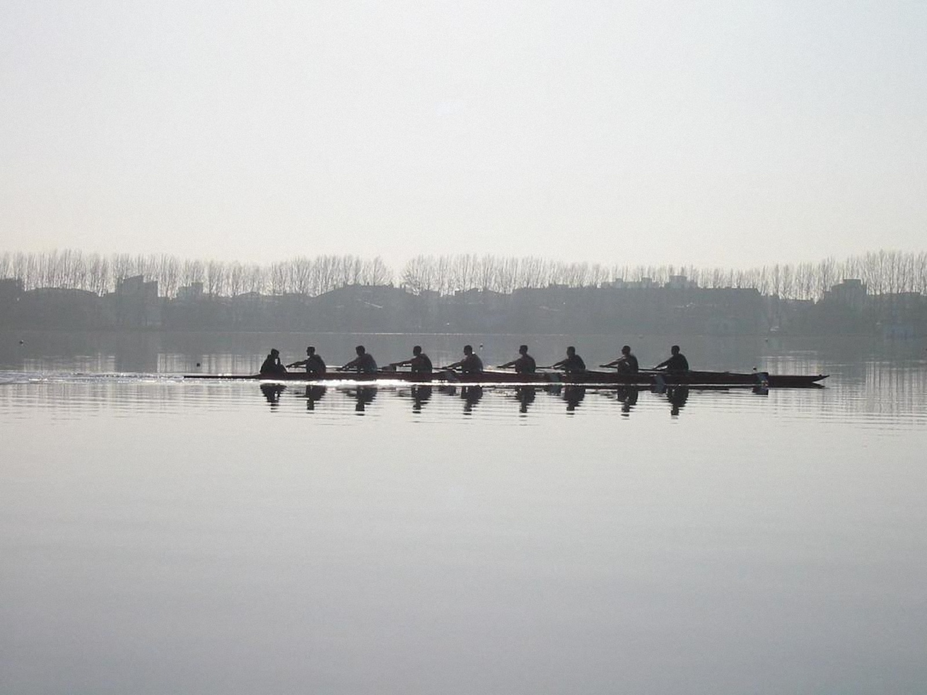
LSE Rowing Club
2012-2013 Season Introduction Meeting
Notes:
Welcome
Thank for signing up
We know some of you haven‘t been receiving emails from us despite joining up. Fault of SU, not us. If you did not receive an email on Tuesday despite having paid for membership then go visit the ARC, which is located above the Quad in East Building, up the spiral staircase to where Alpha Books is. Tell them you aren‘t getting emails and they should sort it out.
Intro to the Club

Slide 2
The Club
LSE Rowing Club
Socials
Rowing, Fitness & Competitions
Charity & Fundraising
Club members and the Committee
Notes:
Probably best to first introduce the club and what we stand for
Maybe explain a bit about club history, how it has evolved
Thee main pillars as I see them are social life, rowing itself and charity
Can expand a bit on each, hint on Pelayo‘s part later on as well as meeting of squads with captains
Point out importance of members to the club‘s functioning (i.e. we are not a extremely well-funded club and need every helping hand we can get)
Can already mention that we are looking for Senior Women‘s Captain, Novice Men‘s Captain and Boatman/woman – will hint at this then bring it up in the Committee section

Slide 3
The Committee
Name | Position
Nikita Nikitin | President
Ben Thies | Senior Men’s Captain
Freddi Muelke | Intermediate & Novice Men’s Captain
Tatum Summers | Novice Women’s Captain
Pelayo Mendez-Valero | Social Secretary
Marcus Jehnke | Treasurer
Tom Meaden | General Secretary
Naomi Gnanapragasam | Kit Officer
Vardhan Kapoor | Press & Website Officer
Jack Curtis | AU Executive Representative
Notes:
- Need to say that we are looking for a boatman, senior women‘s captain and novice men‘s captain

Slide 4
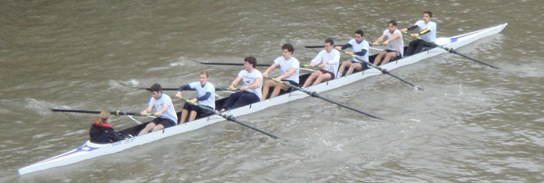
Training
Land Training
Water Training
Erg sessions
Circuit training
Weight training
Team jogs
Outings from University of London Boathouse in Chiswick

Slide 5
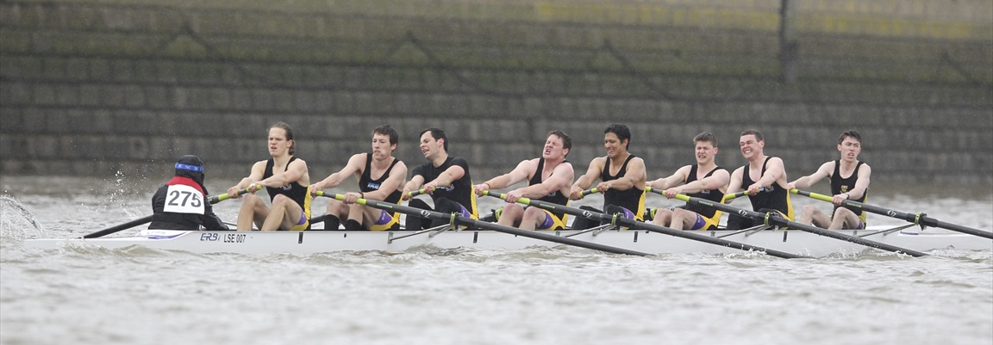
Water Outings
What to wear:
Thermal clothing and layers are best
Make sure to bring spare socks
Rubber boots/Flip Flops
LSE Rowing kit orders before the end of October
How to get to the Boathouse:
Train from Waterloo station to Chiswick Rail station
Approx. 25 minutes
Rowing on the water
requires that you can
swim 25m unaided.

Slide 6
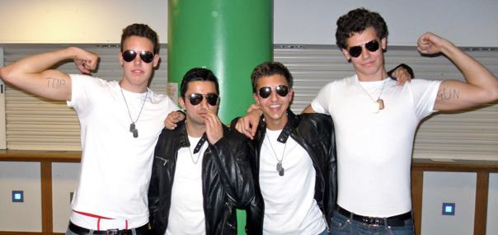
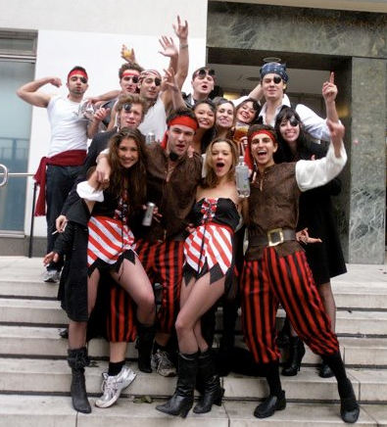
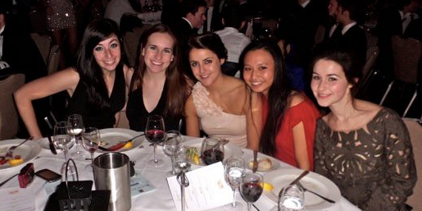
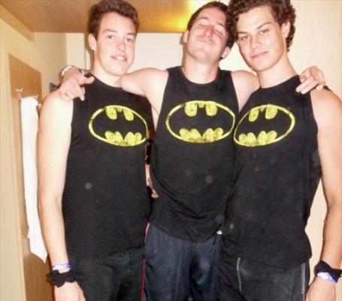
Socials
Regular Socials:
AU nights every Wednesday (Zoo Cards!)
Team Dinners
Coming Up:
AU Welcome Party – 17th October (Tickets on sale!)
Launch Night at Proud (Camden) – 22nd October
Team Dinner – 24th October
Annual Socials:
RAG Charity Row
AU Carol
AU Ball
Paintballing
International Regattas
Tour
And much, much more!

Slide 7
The 2012-2013 Season
Michaelmas Term
Lent Term
Summer Term
Racing Highlights:
Four‘s Head of the River
Cambridge Winter Head
UH Novice Regatta
Allom Cup
Social Highlights:
AU Welcome Party
Carol
Rowing Pub Golf
Racing Highlights:
Men‘s and Women‘s Head of the River Race
Head of the River Amstel
Supaerowing Toulouse
Social Highlights:
Tour – Saloufest 2013!
RAG Charity Row
AU Ball
Racing Highlights:
Metropolitan Regatta
Marlow Regatta
Henley Royal Regatta
Social Highlights:
Henley Royal Regatta
Paintballing
Racing Season
Head Season
Development
April 29th – July 5th
January 14th – March 22nd
October 4th – December 14th

Slide 8
Coming Up Soon…
Saturday 13th October – 1st Intermediate and Senior outing (details will be announced by Captains)
Sunday 14th October – Novice day at the boathouse
Monday 15th October – Training begins for all crews
10th November – Four’s Head, start of the racing season!

Slide 9

Questions?
Website: www.lserc.com
Facebook: www.facebook.com/lserowing
Email: au.club.rowing@lse.ac.uk

Slide 10
Training Schedule

